Slide 1
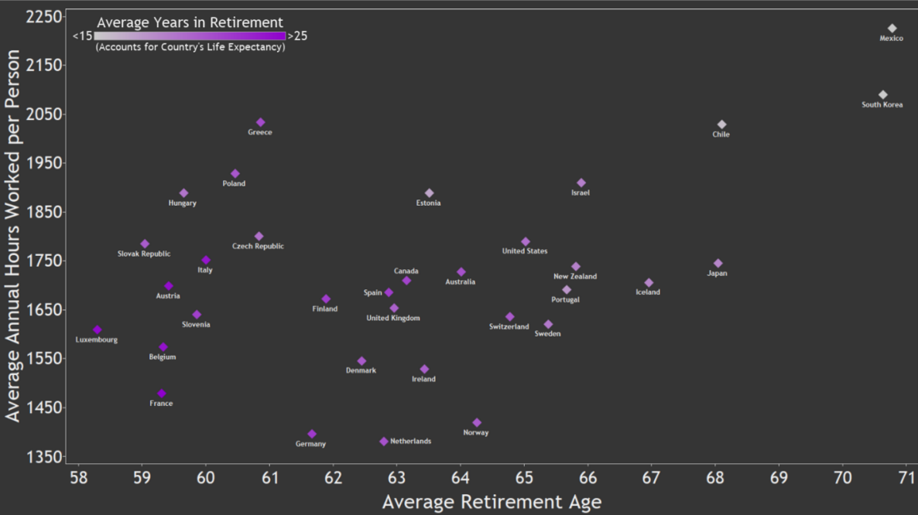
Working Hard, or Hardly Working? |
http://vizual-statistix.tumblr.com/post/61767587684/when-it-comes-to-work-not-all-countries-take-the

Slide 2
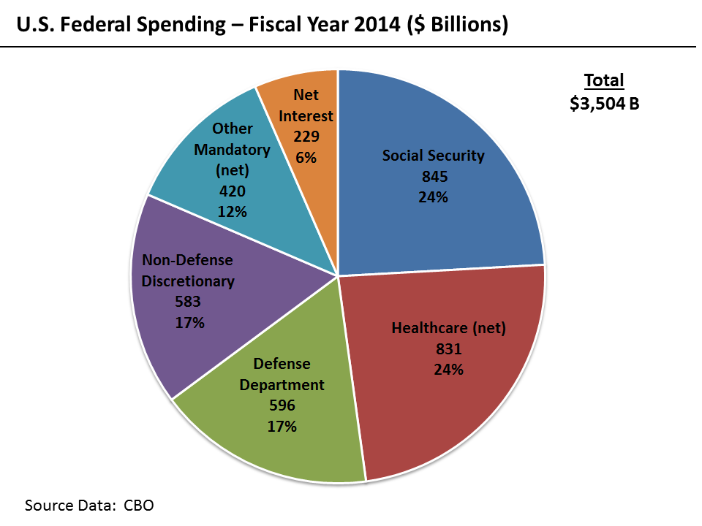

Slide 3
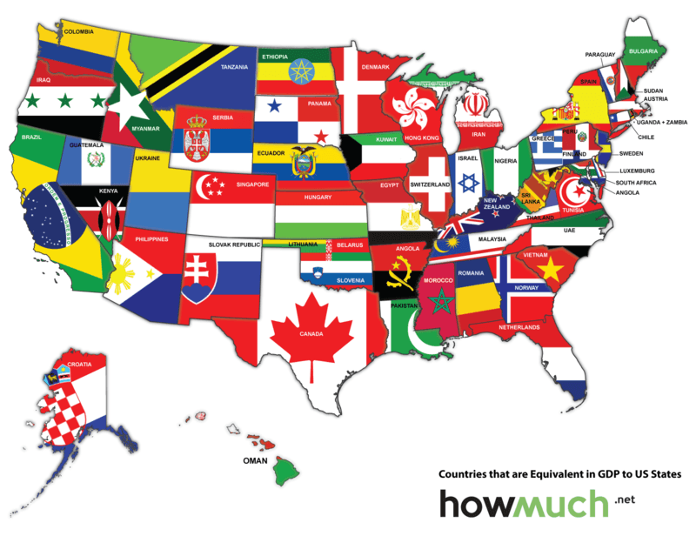
United States of GDP

Slide 4
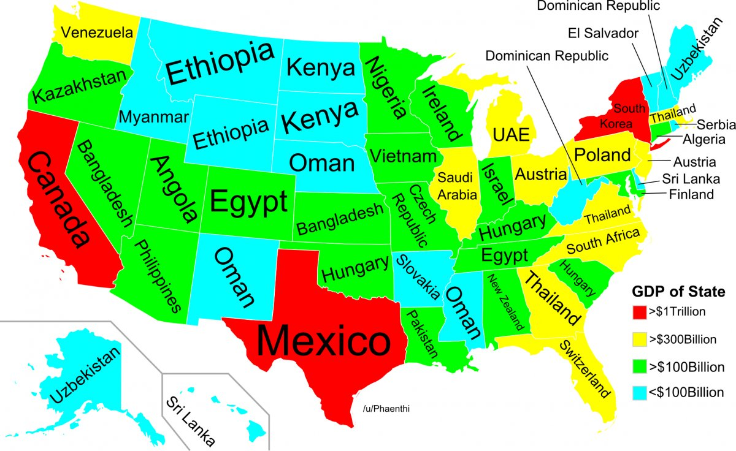

Slide 5
Data
This data was initially collected as a part of California Common Sense’s report titled, “Surveying California’s Unfunded Retiree Healthcare Obligations”.

Slide 6
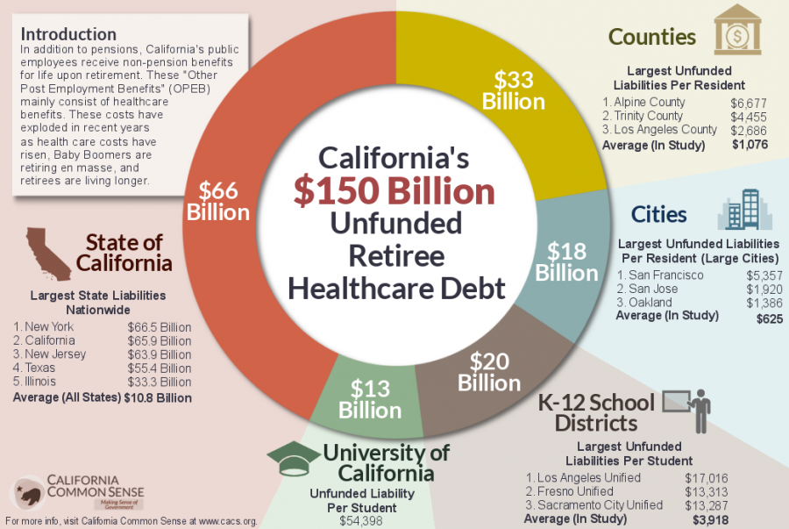

Slide 7
Under the Government Accounting Standards Board (GASB) statements No. 43 and 45, many municipalities began reporting liabilities associated with their other post-employment benefits (OPEBs).
OPEBs include any non-pension retirement benefit, but mainly include healthcare benefits. Typically, when public employees retire, they receive these healthcare benefits for the rest of their lives, or until they are eligible for Medicare These newly updated figures reveal billions of dollars in chronically underfunded OPEB liabilities. Despite that fact, OPEBs have not received nearly the same scrutiny or sense of urgency as their pension benefit counterparts.
Many lawmakers and pension plan managers assumed that the financial prosperity generated by the 1990s bull markets would last indefinitely. Under those assumptions, policy makers increased benefits significantly throughout the state. But investment returns failed to match those optimistic assumptions.
Underfunded liabilities total $1 trillion $433 billion in California alone with OPEB’s being half of them.
Largest part of OPEB is HEALTHCARE

Slide 8
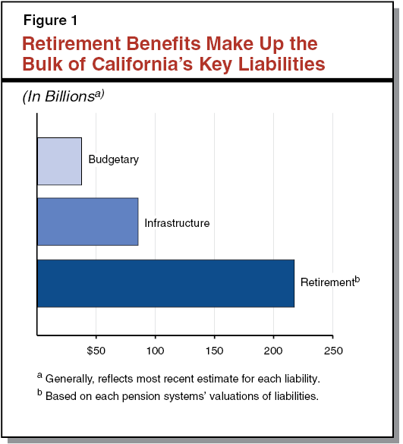

Slide 9
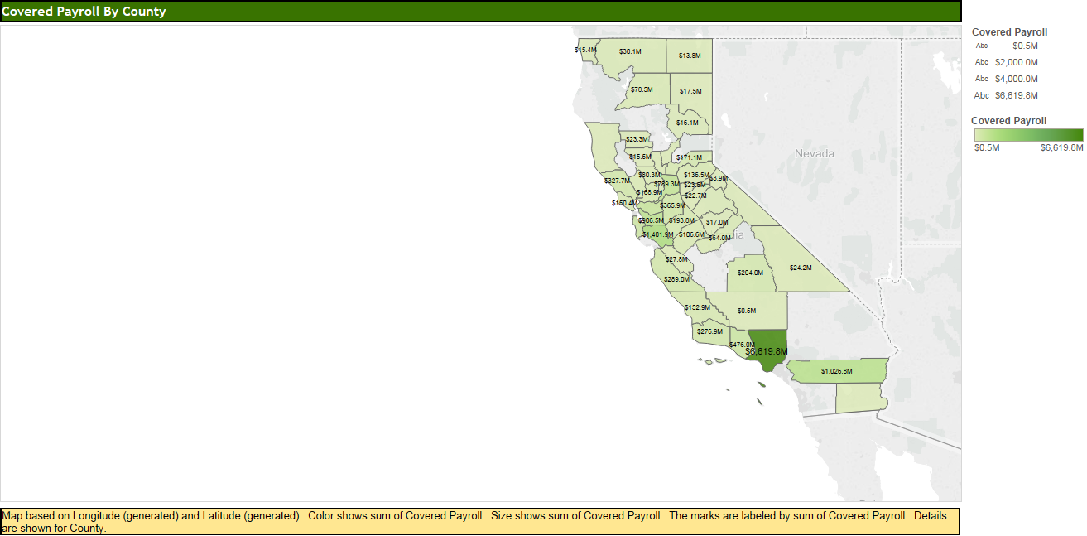
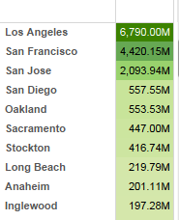
Past

Slide 11
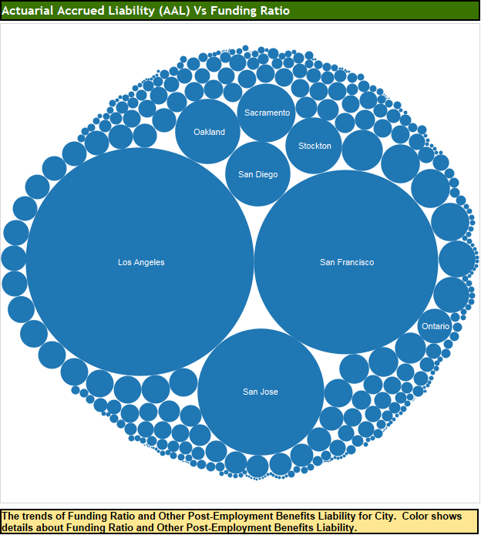

Slide 12
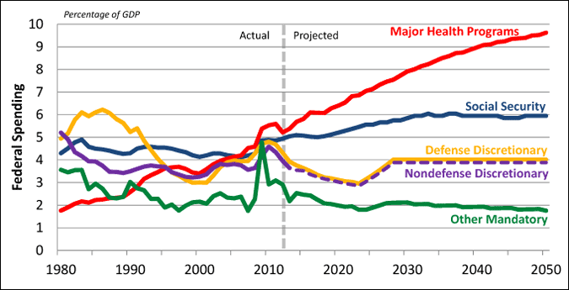

Slide 13
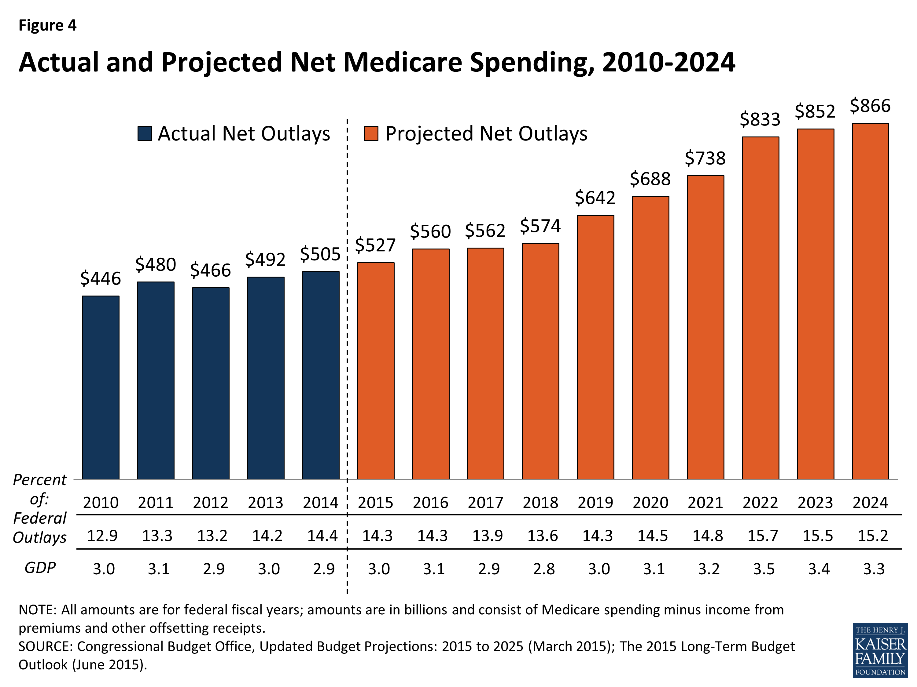

Slide 14
Going forward
intergenerational equity (healthcare and liability appreciation) and reduces future budget uncertainties. The contribution to OPEBs MUST be larger or costs will increase with lower quality, NATIONWIDE and particularly as we saw in the map, in California’s largest population centers
Reduce retirement benefits and cut government employment to better match payroll with assets and reduce liabilities. Most of these liabilities are at the city or municipal level, these aren’t soldiers or veterans, or federal government workers!
Besides paying down liabilities, the only effective way to slow the growth of existing unfunded liabilities is to adjust the benefits current employees have not yet earned. In California, pension benefits for current employees are guaranteed to be at least as generous going forward as they are on an employee’s first day of work. This benefit protection, coined the “California Rule,” is unique in that it applies to benefits that employees will earn in the future, rather than solely to benefits that they have already earned.
More oversight and spending on the federal level to cover liabilities demand adjusting benefits until funding ratio to liabilities are met.

Slide 15
California’s retirement benefit systems are chronically underfunded and require significantly higher contributions to patch funding shortfalls. Given pensions’ strong legal protections, it is inevitable that rising retirement costs will continue to consume larger shares of California’s state and local budgets.
The longer these retirement debts are left unpaid, the more expensive providing benefits becomes, and the greater the risk that the plans will have insufficient assets to provide legally guaranteed benefits. Without substantial reform, future generations will be responsible for paying down retirement benefits earned by previous generations, and at extremely high costs.
Without incentives State government can keep increasing OPEB liabilities. Federal legislation can be used to take away legal gurantes to benefits and incentivize states to allow reform within a more reasonable time frame (ie 25 years from retirement).

Slide 16
Citations
http://cacs.org/visualizations/californias-unfunded-retiree-health-care-liabilities/
http://cacs.org/research/unsustainable-california-the-top-10-issues-facing-the-golden-state-retirement-benefit-costs/
http://blueskygis.blogspot.com/2014/02/united-states-of-gdp.html
http://www.pgpf.org/sites/default/files/sitecore/media%20library/PGPF/Chart-Archive/0133_health_care_projected_federal-crop.gif
http://www.lao.ca.gov/reports/2014/finance/liabilities/addressing-california-key-liabilities-050714-web-resources/image/5227.png
http://cacs.org/research/unsustainable-california-the-top-10-issues-facing-the-golden-state-retirement-benefit-costs/
https://upload.wikimedia.org/wikipedia/commons/2/2b/U.S._Federal_Spending_-_FY_2011.png
https://kaiserfamilyfoundation.files.wordpress.com/2015/07/7305-09-fig4.png

